Slide 1
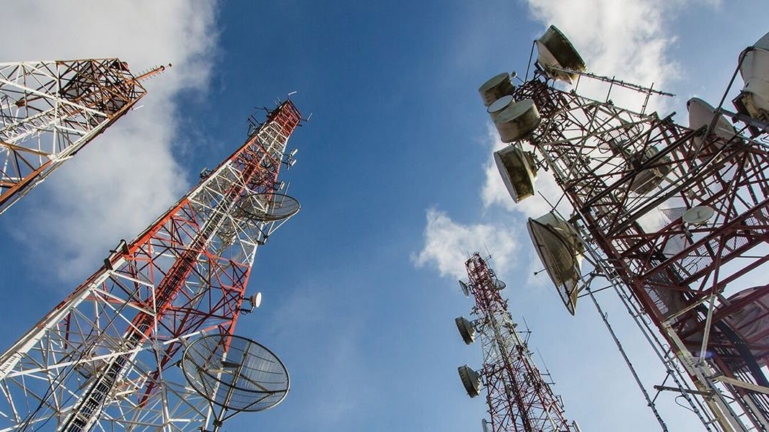

Workshop Sales
Prepared by :
Tarik El MLIH
Contact :
formation@twc.ma
113, avenue Mers Sultan,
Casablanca, Maroc
www.twc.ma

Slide 2
We are
TEAMWORK
Wa are
YOUR PERFORMANCE BOOSTER

Slide 3

FORMATEUR
Global Executive Coach | Speaker | Consultant
Tarik El Mlih

Slide 4
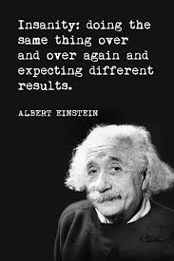
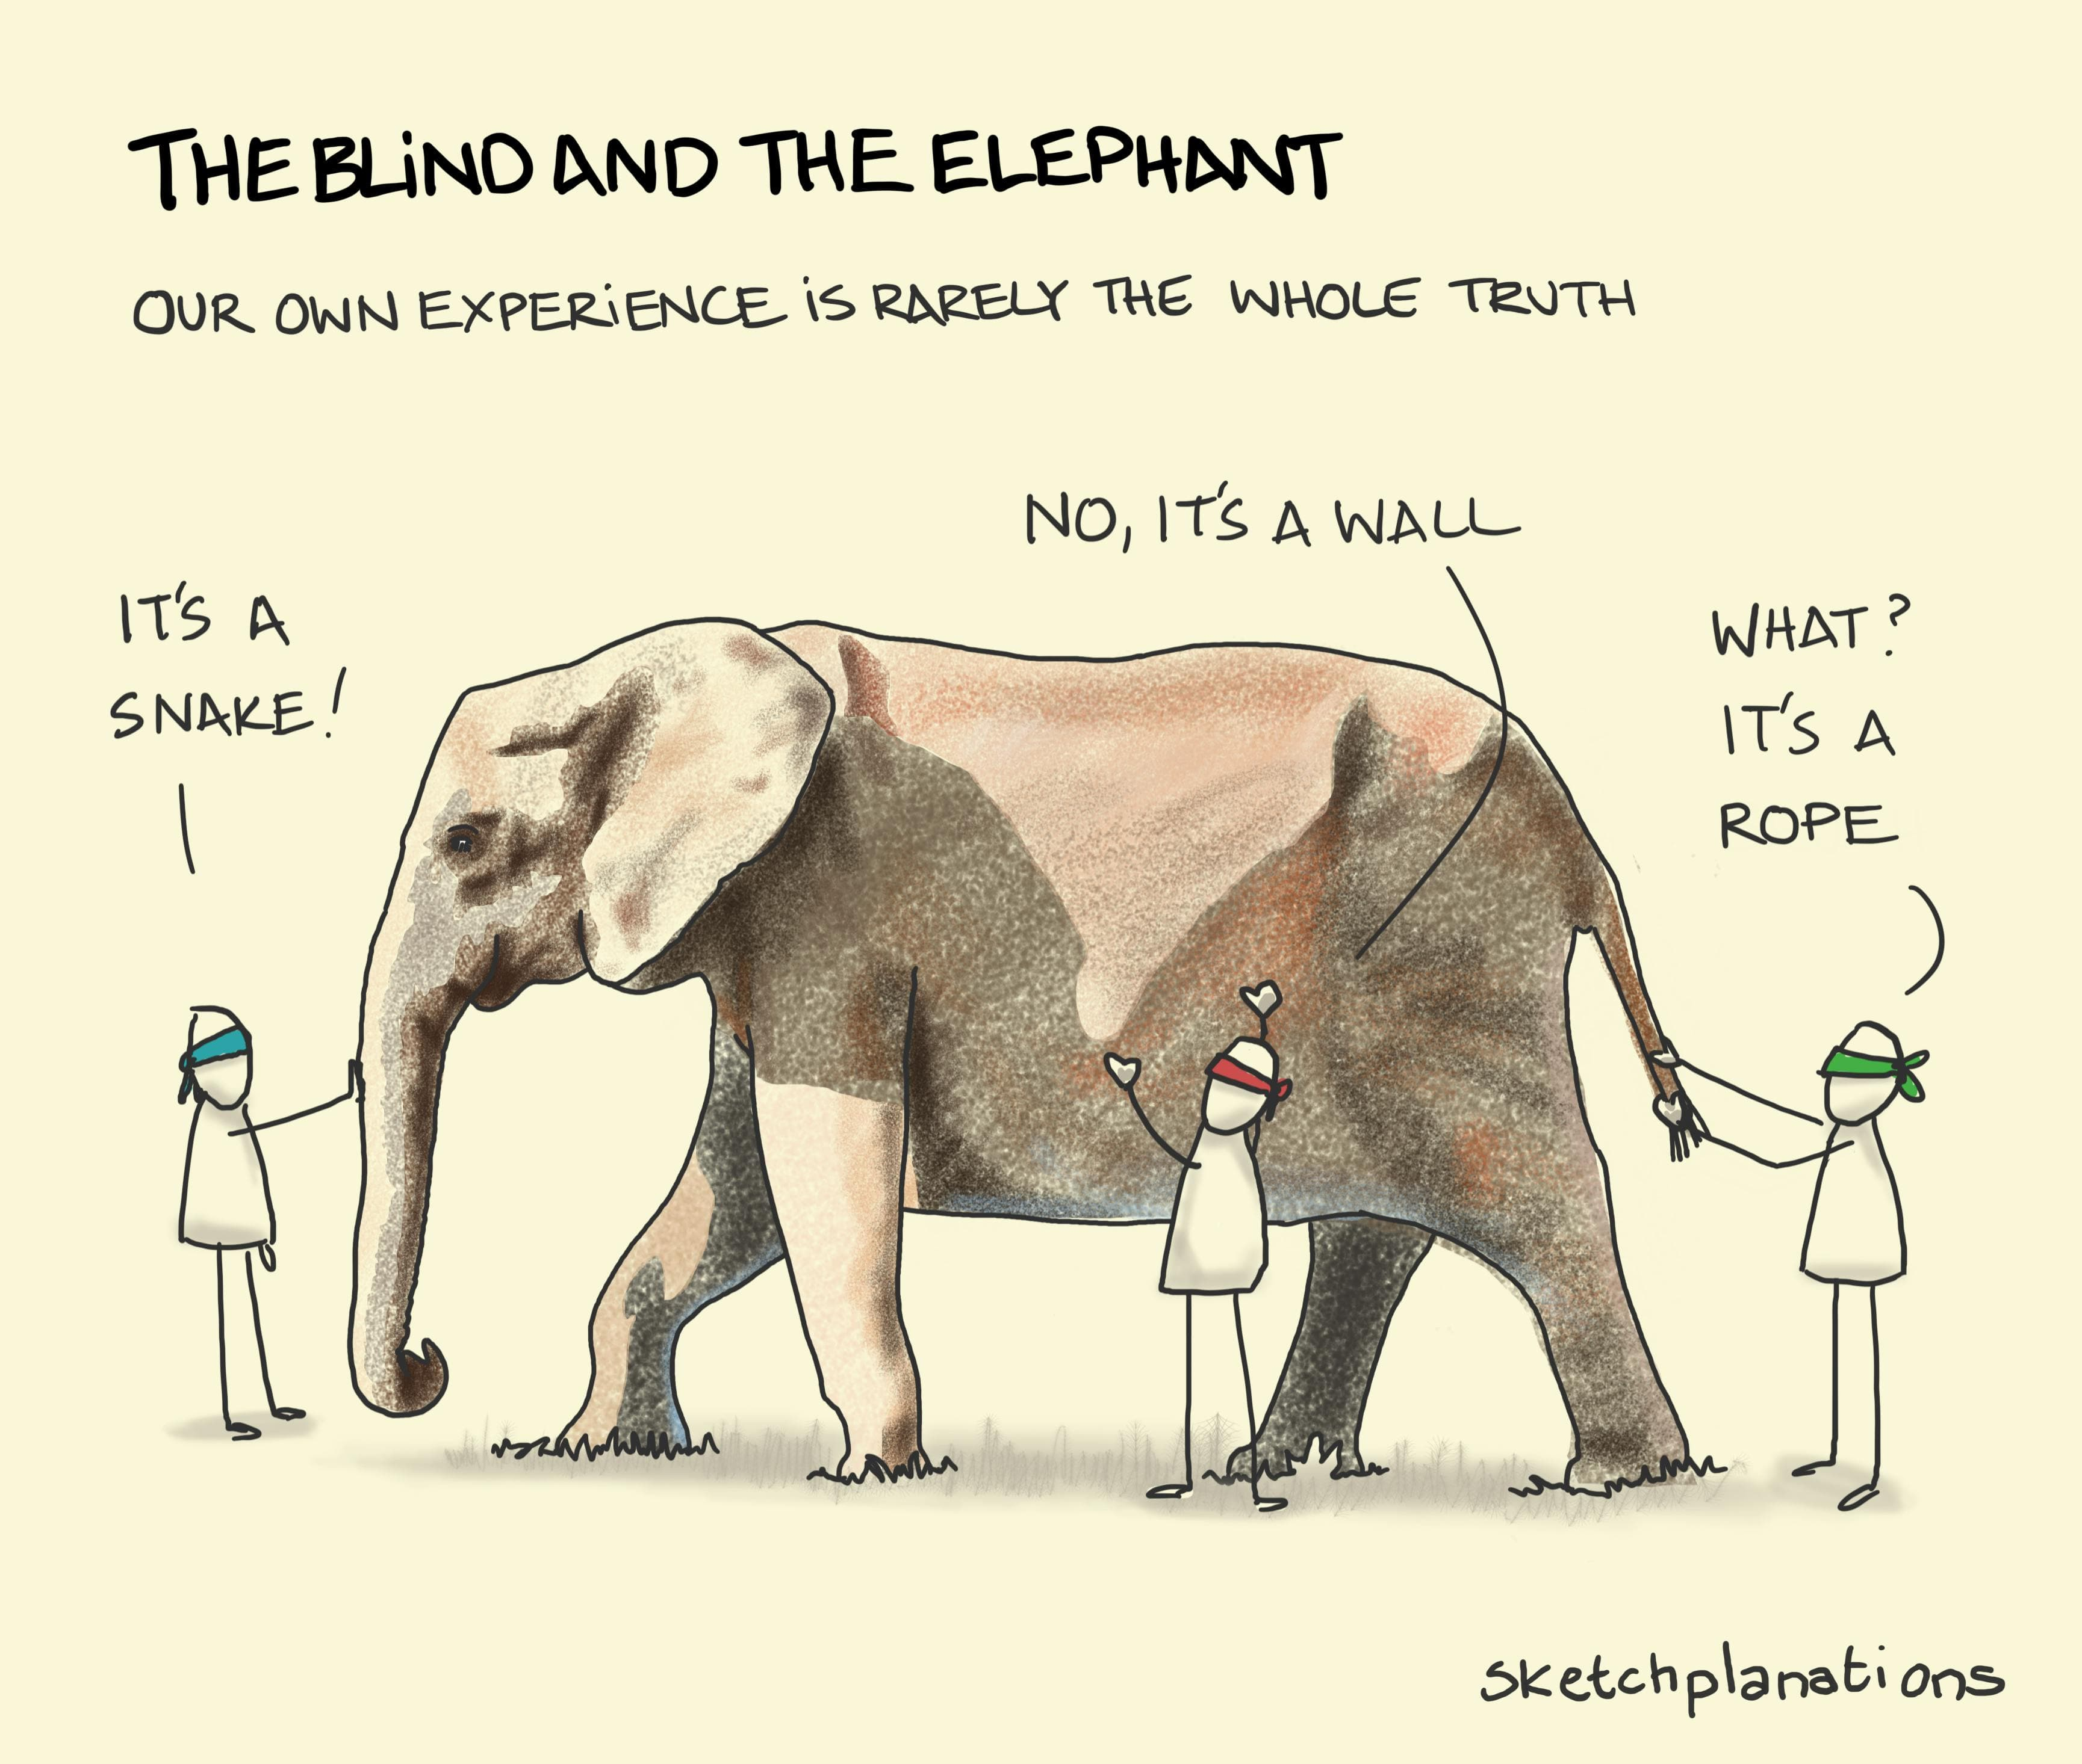

Slide 5
What we are going to discover
Definition of sales techniques
Why sales techniques?
Seller Missions
Sales skills and qualities
Techniques and methods

Slide 6

About Us
Created in 2012, TEAMWORK CONSULTING is a consulting firm specializing in organization, human resources, training and Digital Transformation of HR Processes. Backed by the expertise of our teams and solid arrangements in continuous development since its creation We support several national and international structures.TEAMWORK CONSULTING stands out for its specialized consultants and trainers with complementary, multi-disciplinary profiles and experience. Aiming for concrete results, they support companies on a daily basis in their organization, strengthening their competitiveness, developing employee skills and digitizing internal HR processes, based on a rigorous and innovative methodological approach.

Slide 8

g
g
g
1
2
3
4
Sales Techniques
Seller missions
Actors of a sale
Definition
Why

Slide 9
g
g
g
Definition
1
2
3
4
Sales techniques are all the methods a salesperson uses to increase sales. A sale can be broken down into several stages. The key points in the sales process are discovery and handling objections.
Sales Techniques
Seller missions
Actors of a sale
why

Slide 10
g
g
g
1
Why?
2
3
4
In other words: what impact can sales techniques have on the development of your business?
The answer:
Make a sale and keep your business going.
Get better sales results, generate more turnover, and drive more joy and success from your work.
Sales techniques
Definition
Seller missions
Actors of a sale

Slide 11
g
g
g
1
2
Seller missions
3
4
Prospecting: This is the sales representative's primary task, and it involves bringing new customers into the company.
Communication: to pass on information about the product or service to target customers.
Service: before and after the sale, by being available to the customer and listening to his or her comments.
The actual sale: This concludes the customer approach phase and the commercial presentation of the product or service.
Customer retention: By proposing complementary offers and promotions.
To sum up, a salesperson's missions are :
Turn a prospect into a buyer.
Evolve from an ordinary salesperson to an elite salesperson.
To accomplish the mission of sales, it is necessary to provide the necessary resources to be evaluated in direct relations between a salesperson and a prospect.
Sales techniques
Definition
Why?
Actors of a sale

Slide 12
g
g
g
1
2
3
The 6 essential qualities of a salesperson
4
A - Know what you're selling: Good salespeople have a thorough understanding of the products or services they sell. Their characteristics, the benefits they bring, their prices and those of the market, what's new in the sector.
B - Sharp interpersonal skills: Endowed with excellent interpersonal skills, the best salespeople are not shy. Gifted with empathy, they establish a climate of trust with customers. Their understanding of the problems faced by prospects gives them credibility and confidence.
C - Communication skills for smooth customer relations Communication is at the heart of effective customer relationship management. Listening must be active: when prospects talk to salespeople, they express their problems, and rational explanations are tinged with emotion.
D - Perseverance and patience Successful salespeople need to know how to bounce back from failure: it's inevitable, and practically part of the sales process. Optimism is therefore an essential quality. To know how to sell, you need to have enough ambition and tenacity not to give up.
E – Adaptability An effective salesperson is at ease in all circumstances. They adapt not only to different contacts, but also to all types of terrain. Unlike other sectors of a company, a traveling salesperson's job involves traveling, meeting customers or making a sales proposal to a company manager in a B2B case.
F - Flawless organization To be successful, good salespeople need to multitask. Managing a customer portfolio requires rigor and organization. This quality is highly sought-after in technical sales: it makes the difference between a good salesman and the best salesman.
Sales techniques
Definition
Why?
Seller missions

Slide 13
The actors in a sale
A Seller
A Product
A Buyer

Slide 14
Relationship skills
Examples:
I believe in my salesperson. I'm comfortable with my salesperson. I think my salesperson wants to help me build my offer to establish his or her own. He or she is a valuable resource for me.

Slide 15
Technical skills
Are essential to building an effective sales pitch.

Slide 16
Reassuring behavior
1- Focus on others.
2- Constantly develop your technical skills.3- Plan your days and prepare for sales meetings.
4- Synchronize your behavior with that of your contacts.
5-Divide and conquer, by setting small daily “Quik Wins”.
6- Make links with past experience in the same structure.

Slide 17
Building trust and credibility
Contributes to your enthusiasm.
Supports your morale.
Provides satisfaction.
Allows you to interact with the customer.
Useful for overcoming objections.
Face the competition.
Provide evidence.
Use testimonials.
Demonstrate.
Use logic and rationality.

Slide 18
Tachnical Skills
What is the functionality of your product/service ?
How useful is it?
What satisfaction does it bring?
What answers does it provide to a poorly solved problem?

Slide 19
Procedural skills
Explain to customers the benefits of the product or service you are providing to increase their productivity.
Determine the purpose of the product or service in question, focusing on its usefulness ...
To succeed in your sales, you need to develop your sales talk methodically and with great rigor.

Slide 20
The BEBEDC sales technique
Not every opportunity is good for your company. The BEBEDC sales technique aims to quickly qualify a prospect, in other words, to know whether it's worth starting or continuing the sales process. This means asking yourself the following questions:
● Needs: does the prospect really need my solution? Am I in the best position on the market to help him solve this problem?
● Stakes: what will happen if you do business with this potential customer? And what would happen if you didn't do business? Among other things, this is used to assess the impact of buying or not buying your solution.
● Budget: this involves quickly determining whether the prospect has (or not) the budget that would enable him to solve his problem.
● Timing: is now the right time? Why should they act now? Locking in the deadline allows you to control the sales cycle, but also the impact on your production/resource planning and therefore your profitability.
● Decision-makers: who will validate? Who are the people who can support you, influence you favorably or, on the contrary, “break the sale” for you?
● Competitors: find out who your competitors are for this opportunity, and why they've been approached.

Slide 21
The BANT method
BANT stands for Budget, Authority, Need, Timing. This technique, popularized in the 1960s by IBM, has outlived its usefulness, but is still used today, particularly by software companies. Like the BEBEDC technique, the BANT method is a sort of framework for deciding whether or not to pursue a sales process with a prospect.
● Budget: Does the prospect have the means to fulfill his ambitions? What is the cost of inaction?
● Authority: Who are the decision-makers? Who can derail the sale in the company or, on the contrary, speed it up?
● Need: does the prospect really need our solution?
● Timing: the challenge is to control the sales cycle and decision-making at each stage of the process. Is the customer's problem/need a priority?

Slide 22
Building a CAP sales pitch
A benefit is often observable and responds to what must satisfy the buyer.An advantage is linked to motivation, and is the promise made to the buyer by a simple word or adjective.
A feature is what makes the promise achievable.
A specificity is what makes the feature unique or different from other products.
Developing a CAP sales argument:
Characteristics:
The first element in a sales argument.
EX: a vacuum cleaner with a high-filtration system.
Advantages:
Develop the customer's interest in taking advantage of this feature, based on his buying motives.
Use SONCAS typology (e.g.: retains even the finest dust particles).
Proof:
Convince the customer that the written advantage is real: Demonstration, testimonials.... (Recommended by doctors for people allergic to dust).
Argument = C + A + P

Slide 23
Building a sales pitch
CAB and CAP or how to build your sales pitch Directly linked to SONCAS, CAB (Characteristics, Advantages, Benefits) and CAP (Characteristics, Advantages, Proof) are the two techniques for building and structuring a sales pitch.
● Characteristics: or how to technically describe your solution: features, options, technicality... Depending on the customer's SONCASE typology, this involves listing characteristics relevant to his profile and the problem to be solved.
● Advantages: These correspond to the benefits perceived as a function of all the product's features. Advantages must be highlighted in relation to the customer profile and precisely meet his or her needs.
● Proof: This involves proving the product's benefits based on the detailed characteristics of a given case. These arguments must convince the customer that he too needs the product.

Slide 24
Building a sales pitch: SIMAC
By presenting features, advantages and potential proof or benefits, the salesperson has a structured discourse that enables him or her to anticipate and deal with objections while enhancing your prospect's value. Another acronym for the SIMAC method. The aim of this sales technique is to help salespeople follow the 5 phases of the argumentation process to convince prospects and close.
● Situation: Analysis of the situation, including the prospect's background, needs, priorities, challenges and issues.
● Idea: After analysis, the proposal of an idea to the prospect that could solve their problem. “Do you think XXXXX could be the solution....”
● Mechanism: Once the idea has been set out, it's a matter of detailing how to implement the idea, in particular with an action plan.
● Benefit: As with CAB and CAP, you need to list the various benefits of the proposed solution, personalizing and contextualizing the approach.
● Conclusion: the prospect must approve the solution and validate the chosen action plan.

Slide 25
Building a sales pitch: SPIN Selling
Or the art of asking the right questions
SPIN Selling is the acronym for 4 types of questions highlighted by Neil Rackham in the 70s and 80s:
● “Situation” questions: they provide an overview of the company's context.
● “Problem” questions: these focus on the obstacles and difficulties encountered.
● “Implication” questions: their purpose is to project the scenario that is likely to happen if we do nothing.
● “Need-payoff” (Result) questions focus on valuing the benefits, once the brakes have been lifted. The aim of SPIN Selling is to gradually gain your prospect's trust, so that he or she can then listen to your solution. “SPIN Selling is a highly effective and topical technique, because it enables you to sell without selling. “Or the art of asking the right questions to understand your prospect's issues and challenges. Then “get bought”.

Slide 26
Building a sales pitch
Organization of the argument.
The product sales pitch is divided into 3 parts:
General sales pitch: a list of arguments about the manufacturer, distributor, etc.
Specific sales pitch: a list of arguments about the product's commercial and technical performance. Distinctive sales pitch: list of arguments about the product's innovative features compared to the competition.
Creating the comparative argument
The comparative argument is based on a study of the characteristics of competing products. The following steps must be followed:
Identify competing models of the product
Identify the product's strengths in relation to its competitors.
Develop arguments that highlight the product's strengths.
Clearly advertise the offer | "Which best meets the client's needs." | The solar panels that I offer you fully meet your expectations.
Increase | "By first stating the client's advantage tailored to their needs and profiles." | it is particularly solid
 | "Then you can present the need (and strengthen the argument)." | "Indeed, the fact that it's made of high-strength material allows it to last longer.
 | And by personalizing the benefit thanks to the information obtained during the discovery = customer benefit | "So for you, who are looking to optimize, this is the right solution to reduce your bill."
Control | "To validate your argument: to obtain 'I agree' or 'yes'." | What do you think, Mr. Z?
Chain | "I would also like to emphasize the importance of your role." | "You also told me how important it is for you to

Slide 27
Some rules for better argumentation:
Argue by valuing the strengths of the product compared to competing products
Do not argue too early: not before you have precisely identified the needs and motivations of your client,
Use only arguments that are of interest to the customer Write your arguments one by one,
Involve the customer Use visual media, or demonstrate the product
Repeat the argument or arguments that carry and customize with the phrase “so for you….”
To be convincing……be convinced yourself
More than facts, than reasoning, it is often the enthusiasm of the seller that eventually arouses membership

Slide 28
Aid for argument
The presentation tools are argumentation aids: transparent; video; presentation power point…. . References: a reference is another customer whose problem has been solved by the product sold Testimonials: some people are opinion leaders who have some training effect Images: When the product is complex, you can use a familiar product. For example, "the computer starts by pressing a button like a washing machine" [ Illustrations: The demonstration To increase the efficiency of arguments, use a vocabulary adapted to the client’s SONCAS typology:
S | Security | Customers seek security; they are afraid of risk. They want to be reassured. They like to think, try things, and hesitate.
O | Orgueil (Pride) | Customers seek prestige; they seek to stand out from others; to be valued by their purchase. They are dominant, difficult to manage, self-centered, and proud.
N | Novelty | Above all, customers want to be at the forefront of progress. They are curious and dynamic. They like new experiences and seek originality. They like change.
C | Comfort | Customers seek minimal effort and maximum well-being: ease of use and convenience.
A | Argent (money) | Customers seek savings and value for money, like to compare, and are difficult to manage.
S | Sympathy | Customers are sensitive to the emotional bonds they establish with the brand, product, company, or seller.

Slide 29
Identification and treatment of objection
Identification of the objection |  | Handling the objection
Objection is not sincere and unfounded | "The client resists the idea: 'I need to think.'" | Deepening technique: clarify the objection: “What are the characteristics of this product that bother you?
True objection: unjustified True objection: justified | "The client expresses an unjustified doubt: 'It's a transformer; it's noisy.'" | Technical support: transform objection into argument. "This device is equipped with a new noise-canceling system that significantly reduces the number of decibels."
 | "The client questions in a way that justifies an advantage of the product: 'The cable is too short for a sofa.'" | Weakening technique: reduce the importance of the objection by reframing part of the objection. you are dense in maintenance: it is a fabric which is stain-resistant which makes it easier to clean
 | It’s more expensive | "Yes, but..." Technique Approve the client and offer a complementary argument

Slide 30
Identification and treatment of objection
 | Steps | Actions
1 | Identify the objection | - Identify whether the objection is justified or not - Allow the customer to fully express their objection - Listen with interest
2 | Recognize the objection | - Accept the objection "The product's durability is indeed an important point"
3 | Seek to understand | - Ask probing questions - Acknowledge the customer's responses
4 | Confirm understanding by rephrasing | "Oh yes, I understand" "Actually, you think that's right?"
5 | Address the objection and personalize | - Handle the objection as appropriate By personalizing the response to the customer's specific situation
6 | Monitor the effect of your response | "Have I met your expectations, Mr. X?"

Slide 31
When to deal with the objection?
Before | Anticipate the most common objection to maintain control of the interview
Immediately | When the objection is sincere, it's important to reassure the client because responding to it allows you to move forward in the sales process.
Later | If it's too early to respond given your interview logic (especially objections related to price or those that can be resolved with a demonstration).
Never | If it's a "fake beard," a provocation, or an ironic objection.

Slide 32
The objection on the price
When and how to present your price
The perception that a customer has of a price advertised to them is a function:
The intensity of their need,
From their motivations for buying,
From their financial capabilities,
From its level of information on the product,
Other offers he has
The degree of confidence he has in the seller
For these reasons, the timing and how to present the price are very important:
The price must be presented at the most appropriate time, i.e.:
At the end of the argument when the customer has been able to appreciate all the advantages of the product corresponding to his expectations;

Slide 33
The objection on price
When the seller has refused the objection, he considers to be the last; when he has any doubt, he may ask his customer: “Do you have any other questions to ask me? Or “Do you want more information?”
How to announce the price?
The price must be announced in a clear and natural voice and in an assured tone;
It is imperative that the seller gives the impression that he finds the price quite normal compared to the benefits provided,
The more the customer feels that the seller is sure of his price, the less he will try to obtain a discount, the price must be accurate;
The customer must feel that the advertised price has been calculated and studied accurately,
The price must be printed and not handwritten; it must be kept up to date and never be updated in front of the customer

Slide 34
The objection on price
The price, consideration of benefits,
A price is the consideration for a number of features that provide the buyer with material and symbolic benefits.
A seller should always bear in mind that a customer buys a product not for what it is, but for what it means to him.
In the eyes of the customer, the price may seem justified, when the benefits to him are important.

Slide 35
The objection on price
Techniques | Principle | Example
positioning | Affirm the product's premium positioning | Product X is a high-end, brand-name product.
addition | Add all the advantages together to justify the price | And what's more, you benefit from a 2-year warranty and free software!
subtraction | List the disadvantages that will disappear with the purchase of the product | Because of…you won't have to - ... you won't... .and all this for an investment of X dh, what do you think?
division | Divide the price by the number of days of use over a given period. For example, a year, or over the investment's payback period | his product which. which. which. In addition which.
Multiplication | The advantages provided by purchasing the product are magnified by multiplying them by the duration of use | With this model , YOU save one liter per hundred, or 400 liters of savings per year So 1200 liters of savings over 3 years!

Slide 36
Techniques of explaining and justifying the price
1 | Before closing | Before discussing the price, make sure the product/service is right for the customer. It is therefore a question of pre-closing of the interview by a formula like: "Apart from the price, does the product/service suit you?" This makes it possible to verify that the price will be the last objection to be raised.
2 | Try to understand | Ask about why the customer finds the price high: -Expensive in itself or in relation to competition -expensive due to cash flow problems, budget at the client (rely on funding opportunities), -strategy to obtain better terms or additional benefits -the customer wants to be sure that he has got the best price - it’s a way to avoid and postpone decision making
3 | Explain and justify the price | Use one of the following techniques: addition, positioning, subtraction, division, multiplication

Slide 37
Techniques of explaining and justifying the price
4 | Making a concession in return for payment | If the customer insists with request a discount, the seller can make an effort provided that the customer also makes an effort. In this case, we use the technique of if…then…. this allows “to return the ball” to the customer and obtain compensation in exchange for the discount granted. “If I give you a discount of x%, then do you make the delivery at your expense?”
5 | Accepting a concession for nothing in return | If the customer refuses any consideration and claims a discount _ offer a gift, a payment time, a free, rather than entering the spiral of the discount
6 | Make a discount without consideration | If the customer insists on obtaining a discount: Either the seller categorically refuses by recalling the advantages of the product Either it grants a discount but minimal and insists on the exceptional character of it.

Slide 38
The 7 stages of the sale
The 7 stages of the sale
Preparation: Do research: (Customer, Product, History, Market…).
Get sales assistance tools: (Order form, Business Card, Brochures, Calculator, Calendar…).
Physical and mental preparation: (Being positive, having a sense of purpose, developing self-driving)(clothing, etc.).
This phase allows the customer to be trusted rule create a favorable climate and allow the sale to continue under ideal conditions.
At this stage, it is all about appearance and gestures. First, be calm and control your stress with breathing techniques
Contact: It is divided into 3 steps: Control, presentation, thanks
Contact techniques: The 4x20 decisive, is a commercial practice that is primarily used to trigger a favorable atmosphere and create the conditions for active listening.
The first 20 movements: have a confident and committed approach and attitude.
The 20 cm of the face: look your customers in the eye and smile.
The first 20 words: use a simple vocabulary that is understandable to everyone. Formulate a short sentence to engage the customer relationship.
The first 20 seconds: they are decisive, and the customer’s opinion is forged very quickly. Adopt positive speech.

Slide 39
The 7 stages of the sale
3. Discovery: Making an effective discovery plan to boost sales. Apply the FARP method (facts, actions carried out, results obtained and perception of the interlocutor).
Look for customer needs and motivations for buying.
The SONCAS technique
Use communication and influence techniques useful for the sale Act
Explicitation techniques
Rephrasing techniques – Recovery techniques – Alternative techniques.
Develop empathy and adapt to client attitudes and behaviors
4. The argument: To argue is to convince the customer. Argument is to overcome the customer’s doubts about the benefits of the product or service that one wishes to sell.
It is about presenting the products or services that correspond to the needs of the customer. This presentation must be accompanied by the argument.
CAP: -Characteristics: these are descriptive elements of your product, essentially from a technical and factual point of view. -Benefits: these are the results related to characteristics, translated into beneficial elements.
These are the real “more” your solution brings, and which will “change the life” of your prospect
-Evidence: it is about proving what you just announced above, showing that the characteristics and benefits are real and concrete.

Slide 40
The 7 stages of the sale
5. Objections to be resolved: Objections are negative reactions from the customer to a commercial proposal from the seller. They can be sincere, for example, due to bad past experience but also a pretext to avoid confrontation with the salesman. Never run away from objections, it blocks the sale. There are several techniques for responses to be used in relation to these objections. For example, you can turn the objection into arguments. One of the best techniques to ensure your prospect is to argue using the experience of other users or customers. Thus, by providing an external testimony, your prospect will not feel alone in the face of his future purchase.
Treatment of objections: the frisbee technique in 3 stages
Movement 1: To really welcome things, moving in the direction of objection.
Movement 2: To take charge of understanding, situating and relativizing things.
Movement 3: Making a soft return service allows you to calmly recover.
6. Price négociation/Bargaining : The presentation of the price must be done as soon as possible and obligatorily after giving the benefits to the customer so that he or she identifies the price as an advantage.
Addition
Subtraction
Multiplication
Division

Slide 41
The 7 stages of the sale
Negotiating techniques in front of your prospect (How to succeed in trading with SPANCO?)
Suspect: identify your targets
During the approach phase of your target, you must understand that it is above all suspicious. Not knowing if your product or service can suit it, you must first try to identify the sensitive points that will push it to purchase. To do this you will need to develop personas (i.e. an ideal client representation by including his professional situation, objectives, wishes, dreams etc.). These fictitious people, who will represent a target group or segment, will help you build your qualified file. Use the SONCAS method to detect buying needs and motivations.
Prospect: Argue Once your prospect has been identified and the assurance that it fits your target, you will be more likely to contact them. Present him a solid sales pitch to try to conclude the deal: an attractive offer, an adapted price, satisfactory conditions of sale... Analysis: Listen to your prospect This third step is to best respond to your prospect’s requests. To do this, you will need to use active listening. It will allow you to identify your needs and above all to understand what the obstacles are to a possible purchase. Ask open questions as much as possible and don’t forget to take notes, it will reassure your target
Negotiation: answer objections and negotiate with your prospect During the previous analysis, thanks to your active listening, you answered all the questions of your prospect and you probably reassured him

Slide 42
The 7 stages of the sale
You now know precisely his needs and you have in your hands all the keys that will allow you to enter the negotiation phase.
To avoid losing all the work done so far, carefully consider presenting your sales pitch.
It must be in your favor, while allowing your prospect to receive it as best as possible. You must make your service or need indispensable by showing him the evidence. The goal here is to address a problem and not sell a product. Use the MESORE / BATNA method and show your prospect that you are his best option!
Conclusion: help the act
Now that you have lifted the last objections to the sale, you need to have your prospect make a decision. To do so, you must push it using an implicit phrase to permanently close the sale. Here are some examples: “What are we doing?” “Do we start the project?” “Do you want to order?” Before concluding the sale, summarize the reasons for the purchase (conditions of sale, deadlines, etc.), this step will clearly set the milestones of the customer relationship before entering the commercial management phase.

Slide 43
The 7 stages of the sale
Purchasing order: Build confidence
The final phase of the process is tracking the management of the order. This step is essential, as it helps build customer loyalty and confidence.
You will need to manage the sale and track it very closely and measure your customer’s satisfaction. Remember that you remain the direct contact person for the service provided by your company.
This step should not be taken lightly and may require several appointments so as not to skip the steps and risk losing the sale. To increase its effectiveness, make the SPANCO method yours. You will need to adapt its principles according to your sales cycle, the specificities of your business. With your sales progress chart, immediately identify where your sales cycle is located. Do not try to burn the steps. Selling well is part of time.
Commercial negotiation: To negotiate well, you must have carefully prepared your interview: your objectives, the profile of your interlocutor and his expectations, the competitors in place, your margins of manoeuvre (how far you can go, what concessions are possible for which counterparties...), the answers to possible objections... Combined with active listening, you have all the weapons in hand to become a king of sales.

Slide 44
The 7 stages of the sale
The different approaches to negotiation
Loser/loser
Neither party wants to give in, the negotiation is deadlocked, objectives on both sides will not be met, and the sale is not concluded.
No decision
You are postponing your decision because you are unable to analyze the situation clearly and make the right decision. You need more time to think things through. Only a win-win agreement will ensure a lasting relationship with your new customer. To get from situation A to situation B, you have to be prepared to make concessions. Making a concession in no way means showing weakness. Quite the opposite: it means that you want to work out and find a fair solution that allows both parties to be satisfied.
In a negotiation, everything is negotiable. If your prospect wants to negotiate the price of the product/service you're offering, then negotiate a quid pro quo on your side: contractually accelerate payment terms, increase the down payment from 20% to 30%, obtain a recommendation from three important prospects with whom he can put you in touch, etc.
If you “let go” of something, then you “gain” something else in return. With this technique, everyone let's go and everyone wins (which is fundamentally the most important thing in a negotiation) to reach a satisfactory agreement.

Slide 45
The 7 stages of the sale
Prepare your negotiation
1. What are the criteria for negotiation? ?
2. What concessions from the customer to what agreement ?
3. What concessions on your part for what agreement?
Negotiation: 5 important rules
Dare the high requirement at the beginning of negotiation.
2. Defend each concession.
3. Request and demand consideration for any concessions.
4. Make concessions as small as possible and don't give up anything at once.
5. Keep negotiation under control
6. The closing: If you feel a difficult sale conclusion, you can use the surprise technique of adding a last minute surprise gift as a free shipping or an extra one-year warranty on the service. Or use the watch technique, namely the risk to the customer of losing everything if the decision is not fast. “You know, this is our last product in stock.”

Slide 46
The 7 stages of the sale
Verbal signs | Non-verbal signs
-Affirmation reflecting an attitude user “It’s true that this device will allow me to…..” -Questioning on the terms of sale, "Do you accept credit cards?“ On certain details or on use from the product "What is this controller for?“ On the after-sale services "can you deliver it to me in 48 hours?" Acceptance of the treatment of an important objection such as the price objection He requests the advice of a third party to validate his decision He wants to be reassured -He makes a false objection "I hesitate again" | -The customer is relaxed, confident, no longer has a “barrier” gesture -He changes attitude (becomes silent or on the contrary becomes very talkative) -He smiles, nods his head to approve -He looks at the product, the brochures, touches them, pauses again -He changes posture (gets involved forward or on the contrary takes a step back to think) -It scratches (head, chin)

Slide 47
The 7 stages of the sale
The way to conclude : how to conclude
Technique | Consists to | example
Direct | Going straight to the point, simply... | "We go there? I propose to make what we have just seen together to make the various usual documents possible"
Summary | Summarize the items of the order after obtaining a “yes” from the customer… …. and start filling the order form | “We agree, is this model that suits you best?” “We say, 1…, ref”
Alternative | Suppose that the customer has made his decision, give him the choice between 2 proposals…. . ……and start filling the order form. | “Do you prefer to be delivered this week or next week?” “I’ll note…..Tuesday at 10 am, is that right for you?”

Slide 48
The 7 stages of the sale
Concluding: how to conclude
Technique | Consists to | example
Anticipative | Act as if the customer had made his decision... …. .and start filling the order form | “I’ll see if I can deliver next week….., I call the store…..it’s possible…”
Interrogative or implied | Discuss a point of detail | “What day would you be for delivery?” “I advise you to take the classic model; it’s more suitable, right?”
The shock argument | The seller keeps a last argument in reserve to take the decision when he sees that his customer is still hesitating | “By the way, I didn’t tell you!” “I forgot to tell you that…”

Slide 49
The 7 stages of the sale
7. Taking leave:
Taking leave is as important a moment as welcoming. Starting from the customer, must have a good image of the seller. On the one hand, to reassure the customer about his purchase by congratulating him on his decision or by giving him additional advice and, on the other hand, to encourage him to come back. I advise you to use the simple 4 R technique:
To reassure,
To Thank ,
To associate,
Revisit.
Because remember, taking leave is the last step of the sale but the first step to loyalty.

Slide 50
The 7 stages of the sale
 | In case of sale | In case of non-sale
Communicate | Thank the customer for their welcome and their trust (not for their order) -Congratulate the customer on their decision -Reassure the customer -Reiterate your availability and commitment -Consider their satisfaction at having completed the transaction | -Thank the customer for their time -Stay smiling (control your disappointment at having lost) -Understand the customer's choice (even if you regret it) -Never attack the competition, as this amounts to criticizing the customer who chose to go there.
Preparer the next visit | Show that you are available to the client (business card) - Consider a telephone appointment or a return visit (To note) | Show that you are available to the customer (business card) - Lay the groundwork for a follow-up
Take | -Avoid unnecessary chatter -Leave without rushing "Mr. X, I am delighted to have been able to satisfy you. I am certain that we have laid the foundations for a close collaboration. I wish you a good day and see you next week." | -Avoid unnecessary chatter -Leave slowly

Slide 51
Challenger Sale : Saving the best for last?
If you haven't heard of Matthew Dixon and Brent Adamson's book “The Challenger Sale”, you'll probably rethink your sales approach once you've discovered it.
This method is based on “educating” your prospect in 3 phases:
teaching
tailoring
taking control, so they can choose the solution you've defined for them.
It also classifies salespeople into 5 typical profiles:
● relationship builders: salespeople who seek to create a high-quality, lasting relationship with their customer portfolio
● hard workers: they work hard every day and stay focused on their objectives
● lone wolves: those who work alone, in their own corner (there are some in every company, like Jean-Pierre, 30 ans de maison...)
● Problem Solvers: those who are desperate to find a solution to any problem encountered by the prospect.
● Challengers: those who propose a new way of thinking and are by far the most effective.
The 6 stages of the “Challenger” profile that punctuate the sales pitch:
1. Warmer” stage: quickly identifies the target's needs, context and issues.
2. Reframe” stage: redefines the potential customer's needs by pinpointing a specific issue.

Slide 52
Challenger Sale : Saving the best for last?
3. Rational Drowning” stage: the challenger knows how to demonstrate that this problem has a strong impact on the prospect's business, preventing him from moving forward and achieving his objectives.
4. Emotional impact” stage: human beings are more afraid of losing than they are of winning. So a sentence like “You're losing money every month” or “You're wasting an incredible amount of time managing these tasks with your two assistants on the job” often hits the nail on the head, because it taps into the prospect's emotional wellspring.
5. Value proposition - A new way” stage: the Challenger knows how to present in detail the solution that could put an end to the prospect's problem. 6. Our solution and implementation way": finally, the Challenger explains how the solution will be deployed and how his company will support it.
Mindset Shift
-To be
-Do
-Have

Slide 53
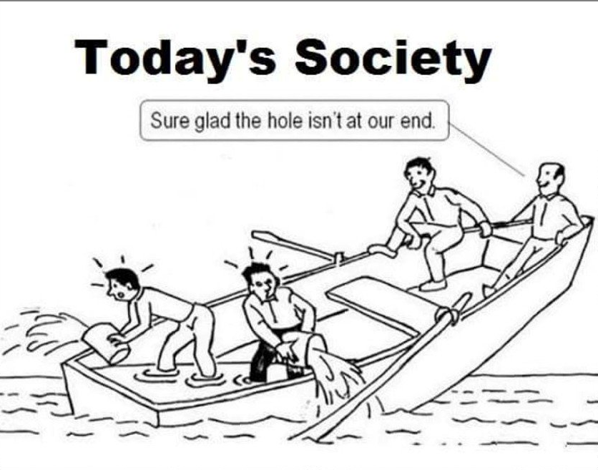

Slide 54
